Slide 1

MINI PROJECT
ON
VEHICLE TO VEHICLE COMMUNICATION SYSTEM
Project Group ID: F3 Section: F
By
SACHIN SHARNGOWDA R16CS355
SAGAR.B.DOLLIN R16CS356
SANJAY.K.R R16CS370
SANJAY KUMAR .K R16CS371
Under the guidance of
Mr. Manjunath P.C.
(assistant professor)

Slide 2
CONTENTS
ABSTRACT
INTRODUCTION
PROBLEM STATEMENT
PROBLEM SOLUTION:V2V COMMUNICATION
UNDERSTANDING OF PROBLEM
CASE STUDIES
MATHEMATICAL REASONING AND IMPLEMENTAION
SYSTEM REQUIREMENTS
ARCHITECTURE
APPLICATIONS
CONCLUSION OF PHASE 1
REFERENCES

Slide 3
ABSTRACT
This project focuses on controlling the road traffic by demonstrating various traffic situation and how they can be overcome.
Our project aims to add more features to autonomous vehicles to control traffic and to reduce accident risks .
This will be demonstrated using mini RC CARS using Arduino. Clearly autonomous vehicles are the future and we work for a better future.

Slide 4
INTRODUCTION
Our project aims to control the traffic and save a lot of precious time. Each vehicle on the road is an independent vehicle irrespective of whether it is autonomous or manually driven.
Our goal is to connect all the independent vehicles to a server that regulates traffic. This system will provide a new dimension to autonomous vehicles as independent autonomous vehicles depend mostly on visual data that they get from the surrounding.
Creating a link between them would result in taking more accurate and appropriate decision. Our project demonstrates the creation of link between vehicles to avoid traffic jams and accidents by using mini RC CARS and implementation of Arduino.
These mini cars would be able to communicate to each other via a computer which will act as a server and we intend to design an algorithm that would regulate the traffic of these mini cars.
Every car would be aware of the surrounding cars- their speed, direction, the route that they intend to go. This will Provide a broad range of data to make more accurate decisions by the algorithm.

Slide 5

Meet Peter
A school going kid.
PROBLEM STATEMENT

Slide 6
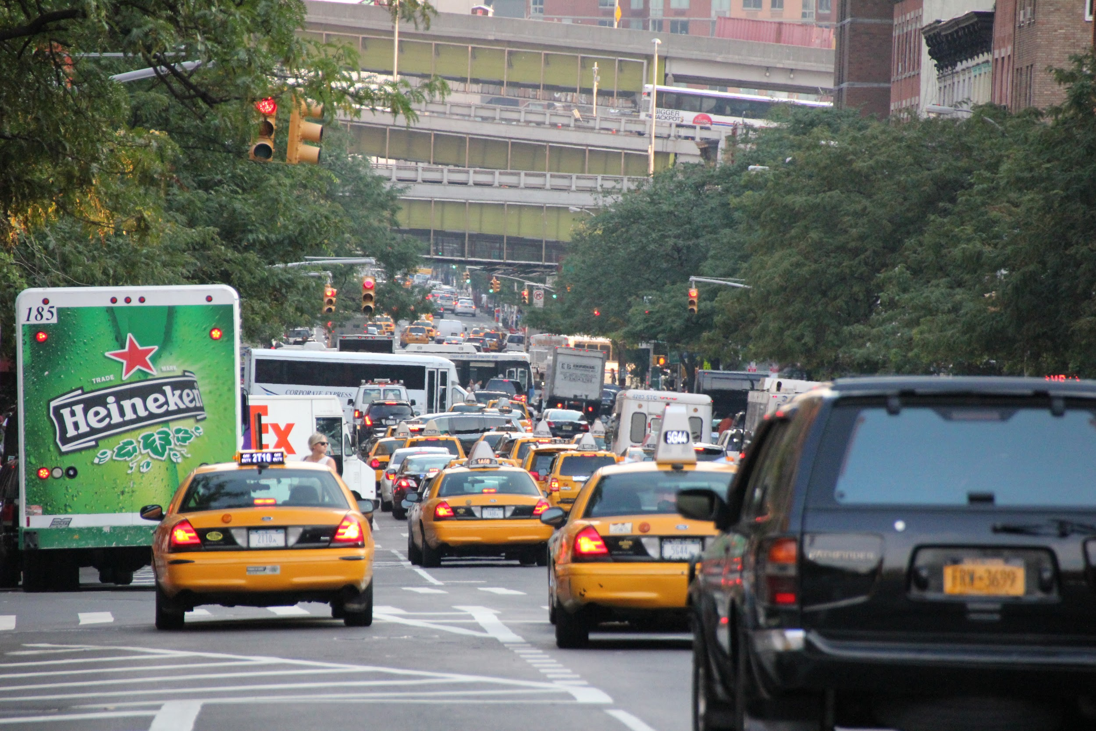
This is how Peter’s way to school looks like

Slide 7
The observations that peter made on his way to school are:-
It takes at least 45 mins to cover the distance of 10 kms.
Usually the ambulances get stuck in the traffic
Sometimes the traffic police are unable to clear the traffic on time.

Slide 8
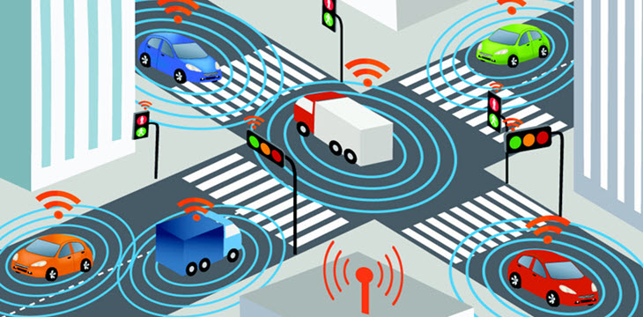
Vehicle to vehicle communication can save time,fuel and lives.

Slide 9
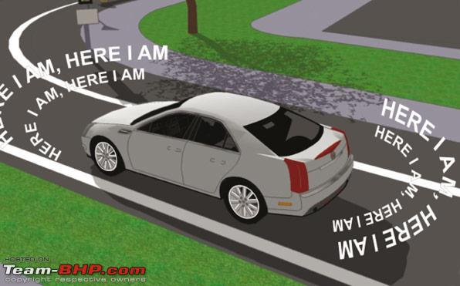
Basic Model:
Sharing of data A.speed B. position C. projected path

Slide 10
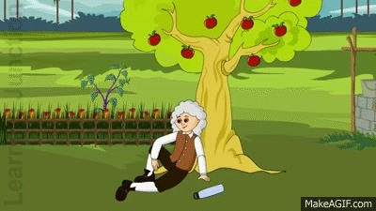
Meet Dr. Mewton
He is all about math and he has presented us a collision problem
We will also be able to tackle the problem of accidents.

Slide 11
R(v3,d3)
There are 3 ways in which the particles may collide;
PQ collision
QR collision
PQR collision
PR collision
There are several ways in which the collisions can be avoided
We will consider 8 practical possibilities.
P(collision)=4/12=0.3
C
Q(v2,d2)
P(v1,d1)

Slide 12
Our algorithm chooses one of 6 possible solution to avoid collision.

Slide 13
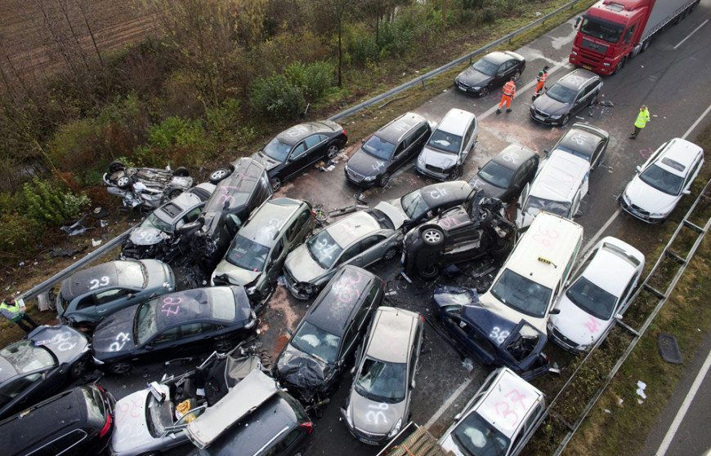
Lets have a look on possible practical collisions.

Slide 14
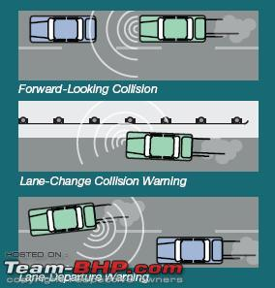
These are few scenarios possible of collision while on road.
Forward looking collision
Lane change collision
Lane departure warning

Slide 15

The solution to all these problems are implemented in the following ways:

Slide 16
1)Platooning
v1
v2
v3
Where
v1=v2=v3 ...

Slide 17
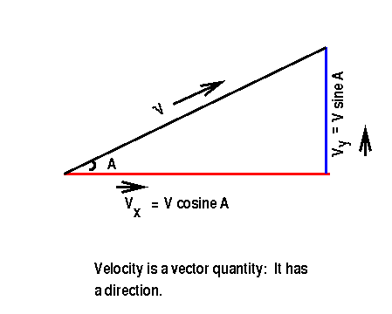
2)Lane change solution
Before going to the solution Dr Mewton wants us to recall the velocity vector problems.

Slide 18
What must be the velocity of both the vehicles to avoid collision?
Are the velocities relative?
Left lane
B(v2)
Right lane
A(v1)

Slide 19
Here to avoid collision the horizontal velocity of both the vehicles must be equal.
Therefore,
v1=v2cos𝛳
This implies
v2=v1/cos𝛳
I.e.,
v2=v1sec𝛳
v2cosθ
𝛳
v2
v1

Slide 20
3)Lane change warning
A(v1)
B(v2)
Left lane
C(v3)
Right lane
In this case when B changes lane then it must send a warning to A and C so that they both can be platooned i.e.,
v1=v3

Slide 21
4)U-Turn/turn Warning
Left lane
Right lane
A(v1)
B(v2)

Slide 22
5)Blind spot warning
B(v1)
A(v=0)

Slide 23
UNIFIED SOLUTION

Slide 24
THE CIRCLE ALGORITHM

Slide 25
B(D2,V2)
V1cosΘ=(y-x)/t
V2=x/t
Collision Ratio
(V1/V2 )cosΘ =(y-x)/x
Or we can write the collision ratio as
z(y-x)
= --------
zx
Where z is any real number.
x
P
y
ፁ
A(D1,V1)
C(D3,V3)

Slide 26
SYSTEM REQUIREMENTS:
As we have mentioned earlier, we will be using RC CARS to demonstrate real life situations of traffic.
The RC CARS will be connected to computers through arduino . We will need Arduino software to do it. And rc board that is used to use a RF controlled car to be connected using antenna.
We will also need transmitters and receivers to be able to send and receive data of the speed , location and direction of the cars .

Slide 27
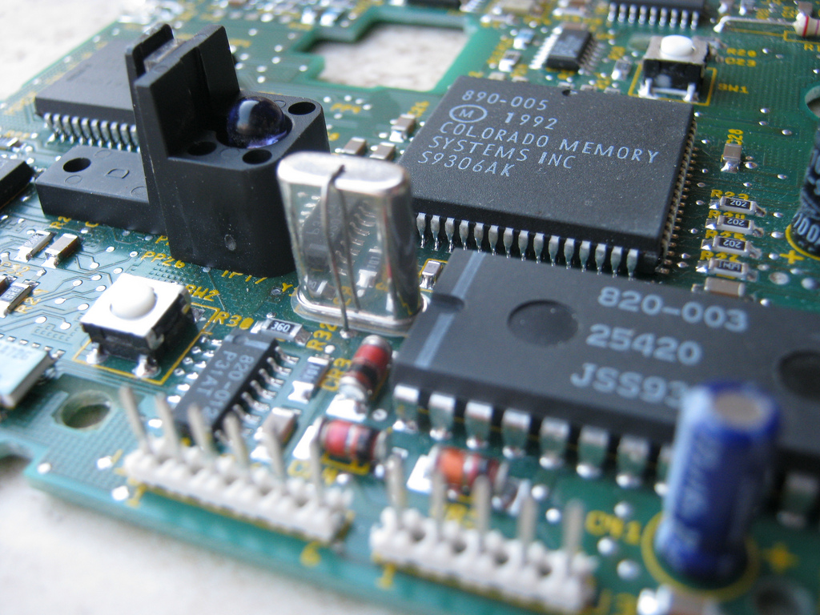
HARDWARE REQUIREMENTS:

Slide 28
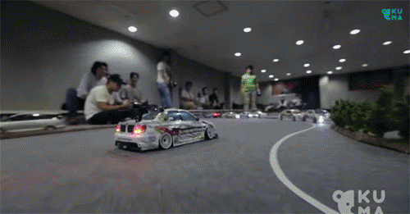
RC CARS

Slide 29
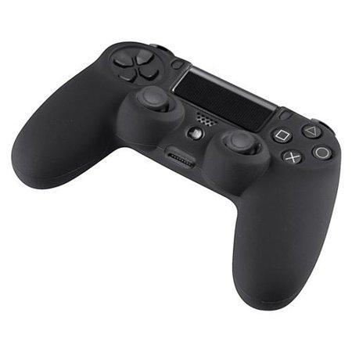
REMOTE CONTROLLER

Slide 30
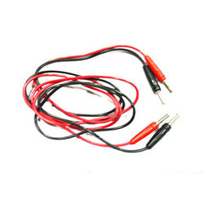
PATCH CORDS

Slide 31
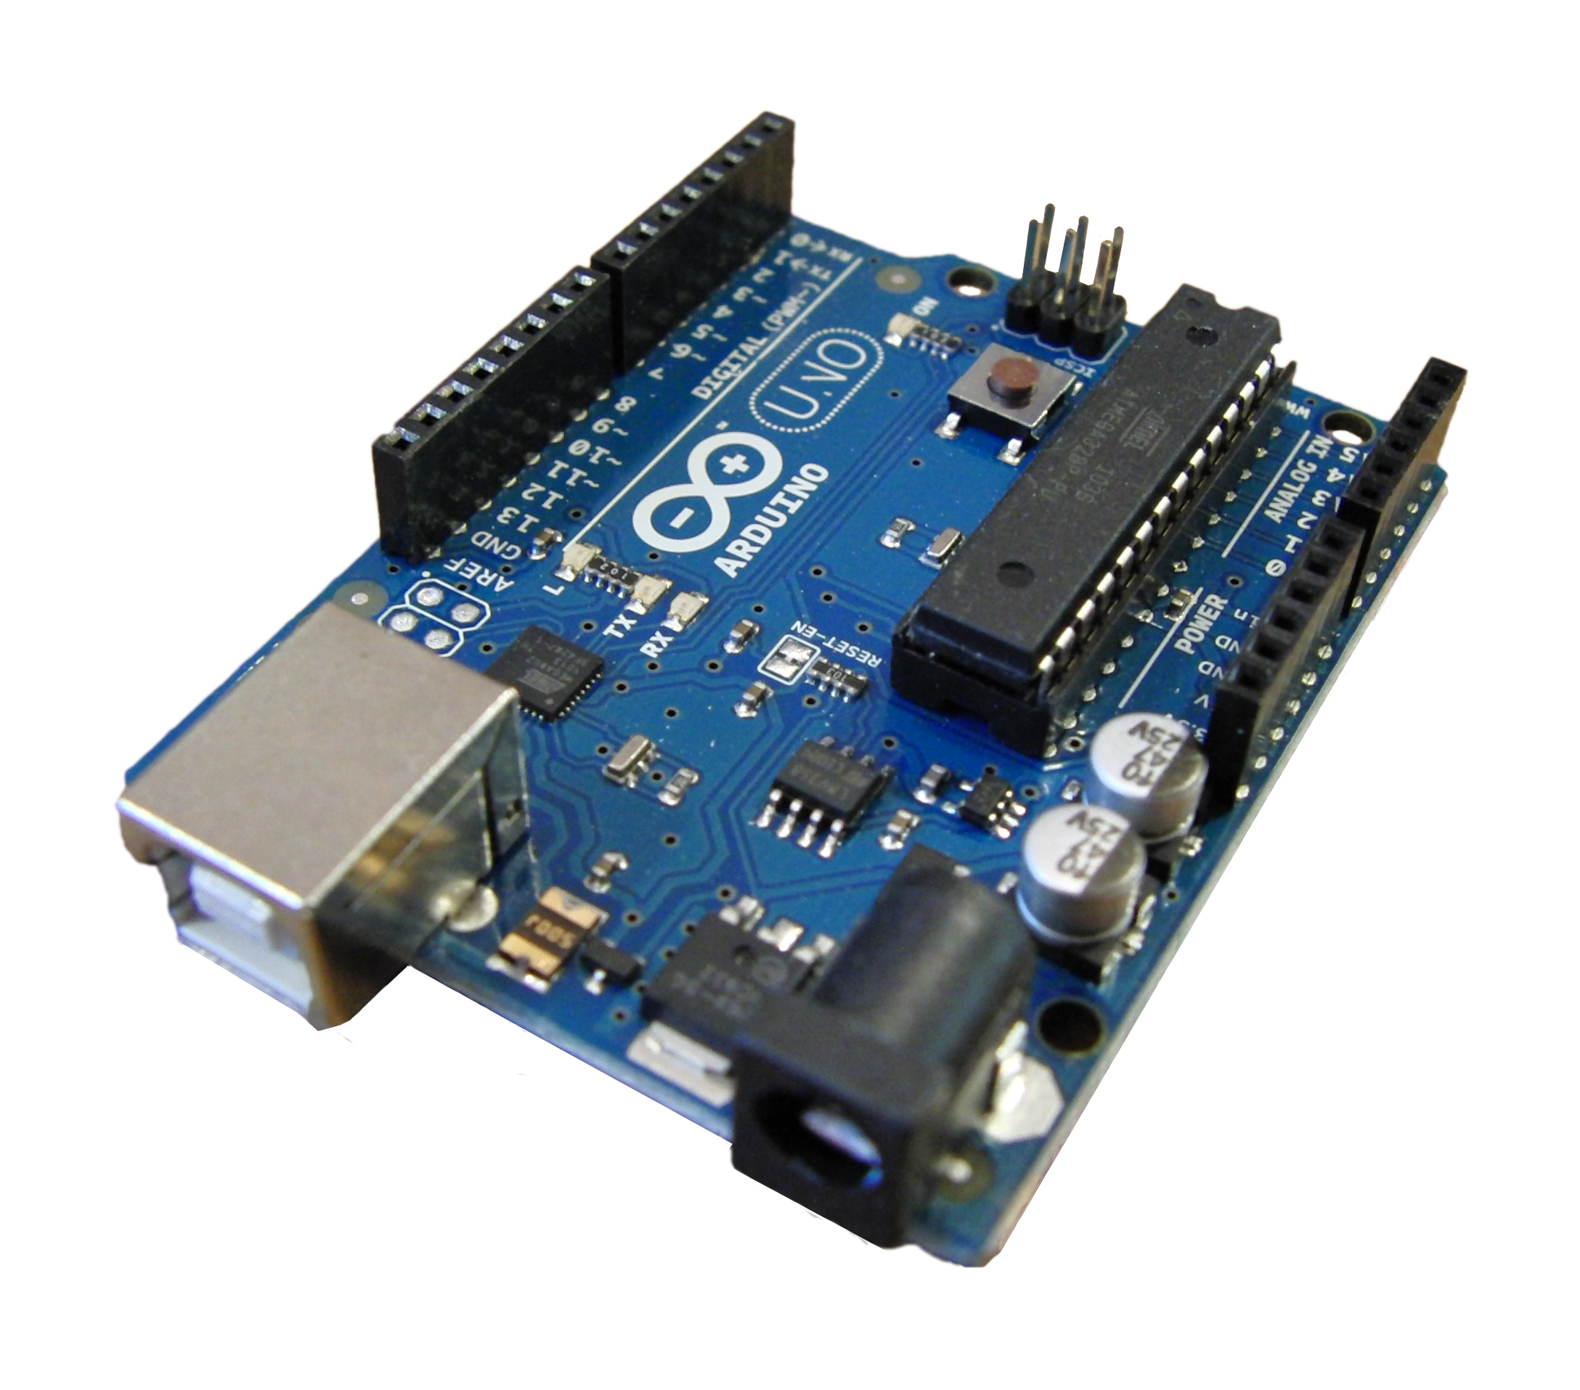
ARDUINO UNO

Slide 32

SERVER SYSTEM

Slide 33

SOFTWARE REQUIREMENTS

Slide 34
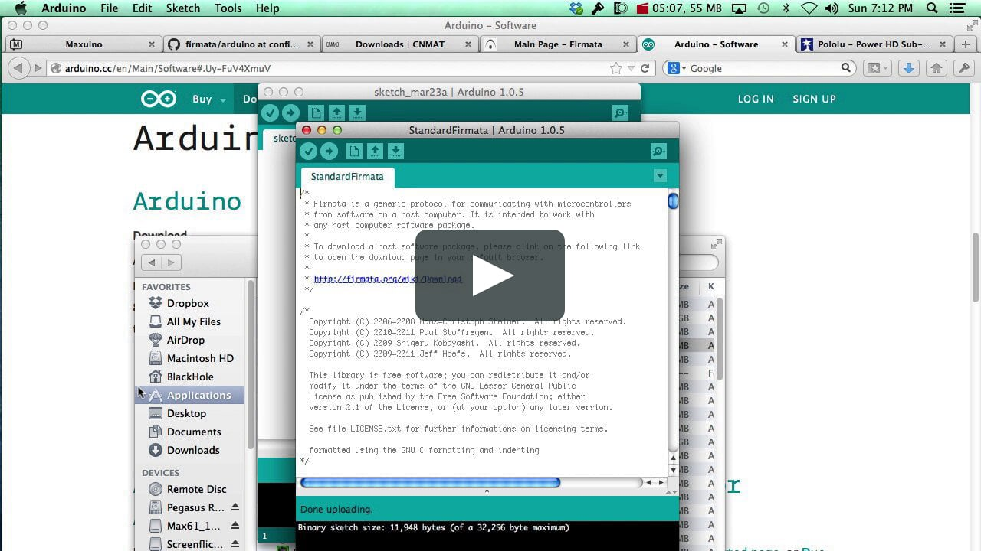
ARDUINO APPLICATION

Slide 35

OPERATING SYSTEM PLATFORM

Slide 36


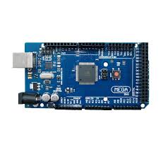
ARCHITECTURE:

Slide 37
APPLICATIONS
As we have highlighted the main objective earlier i,e. to clear the traffic and regulate it there are other important objectives that needs to be brought into the light.
As we stated before the vehicles would foresee an emergency vehicle approaching before it gets any closer an appropriate decision to make way for the emergency vehicle is taken.
If two vehicles approaching at an intersection from different routes knew about each other's positions beforehand the accident could be avoided easily.
Platooning can be achieved easily where number of vehicles using same routes are grouped together at equal distances and one vehicle leads them sending information of the upcoming hurdles beforehand. Platooning is effective on highways and isn't very useful on busy roads .

Slide 38
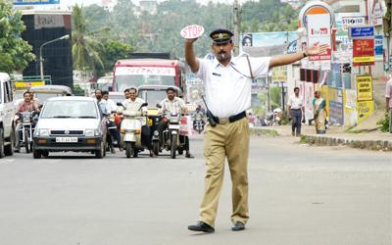
Traffic control

Slide 39
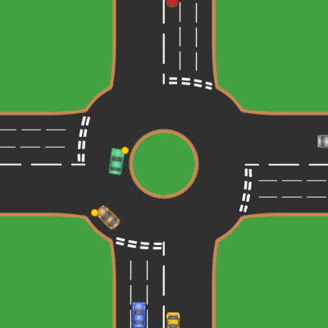
Safety at intersections

Slide 40
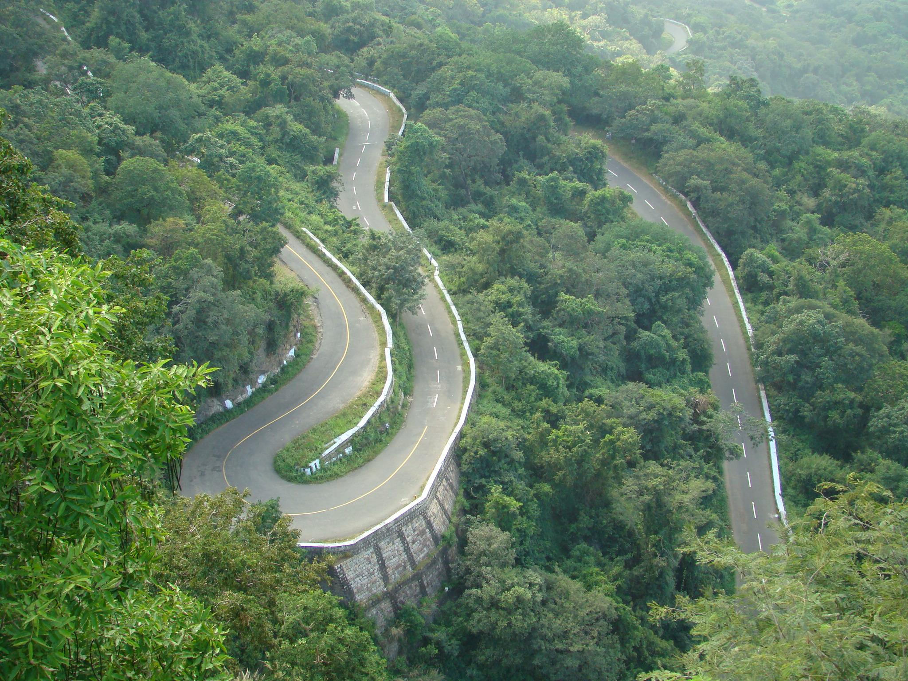
GHAT SECTION WARNINGS

Slide 41
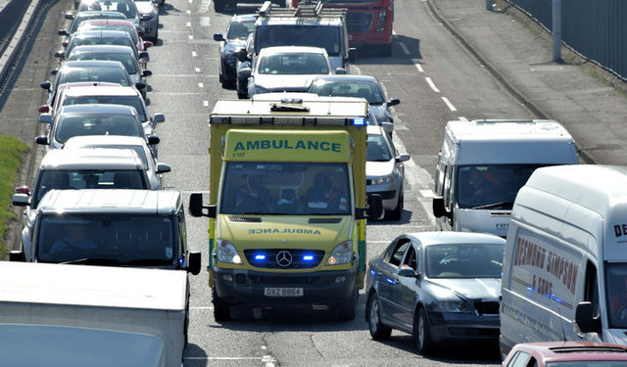
EMERGENCY VEHICLES

Slide 42
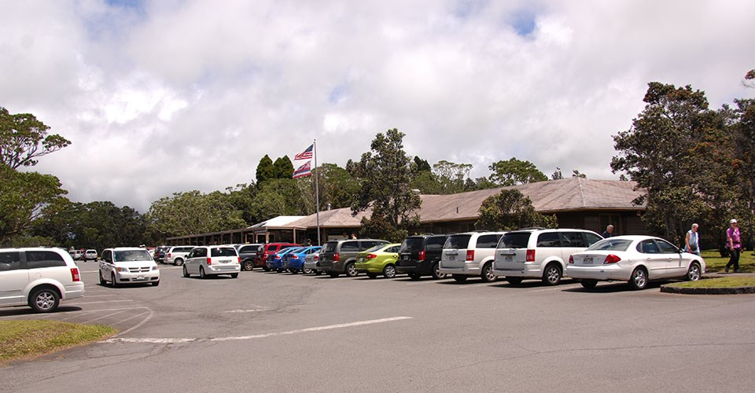
AVOIDS PARKING
CONGESTION

Slide 43
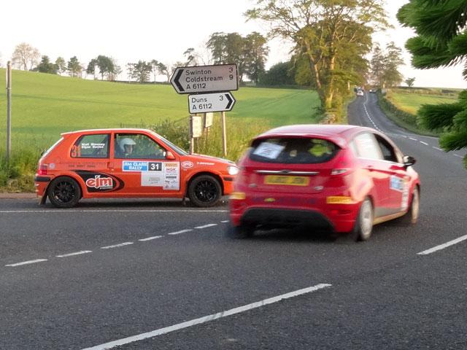
AVOIDS BLIND SPOT
ACCIDENTS

Slide 44
CONCLUSION PHASE 1:
AS PRESENTED EARLIER OUR ALGORITHM IS BASED ON THE MATHEMATICAL EQUATIONS EXPLAINED EARLIER.
WE HAVE TRIED TO DERIVE SUCH EQUATIONS BASED ON FEW COMMON SCENARIOS.
THE ALGORITHM IS STILL UNDER DEVELOPMENT.
WE WILL BE USING WiSHIELD WHICH IS IMPLEMENTED TO CONNECT TO THE MC AND THE RC CARS.
IF WE WANT TO USE BLUETOOTH WE REQUIRE OTHER HARDWARE COMPONENTS.

Slide 45
REFERENCES:
"Dedicated Short Range Communications (DSRC) Home". leearmstrong.com. Archived from the original on November 19, 2012. Retrieved 2008-02-29.
M. Peden; Richard Scurfield; D. Sleet; D. Mohan; et al. "World report on road traffic injury prevention" (PDF). World Health Organization. Retrieved 2008-02-29.
"Crashes Vs. Congestion -- What's the Cost to Society?"(PDF). American Automobile Association. Archived from the original (PDF) on 2012-02-01. Retrieved 2011-11-30.
"Vehicle Infrastructure Integration (VII)". its.dot.gov. Retrieved 2008-02-29.
"The world health report 2002 - Reducing Risks, Promoting Healthy Life". World Health Organization. Retrieved 2008-02-29.
"First Toyota cars to include V2V and V2I communication by the end of 2015". IEEE. Retrieved 13 April 2017.
"Technical Approach". Car 2 Car. Retrieved August 13, 2016.
US, van Oldenborgh, et al., "SYSTEM AND METHOD FOR DISTRIBUTED DATA NETWORK HAVING A DYNAMIC TOPOLOGY OF COMMUNICATING A PLURALITY OF PRODUCTION NODES WITH A PLURALITY OF CONSUMER NODES WITHOUT INTERMEDIATE NODE LOGICALLY", issued June 20, 2006
Bigelow, Pete. "Feds Want V2V Communication in New Cars Starting in 2021". Car and Driver. Retrieved 29 January 2017.
Harding, J (2014). "Vehicle-to-vehicle communications: Readiness of V2V technology for application" (PDF). nhtsa.gov.
Austroads. "Austroads' Submission to the '2014 Review of the Motor Vehicle Standards Act 1989" (PDF). Department of Infrastructure and Development (Australia). Retrieved 29 January2017.
"Radiocommunications (Intelligent Transport Systems) Class Licence 2017". Federal Register of Legislation. Retrieved 9 October 2018.
"UC Berkeley-Audi Pact Places Smart-Engine Research on Bay Area Roads". berkeley.edu. Retrieved 2008-02-29.

